Slide 1

Electrical Safety Devices
SAL TECHNICAL CAMPUS
SAL Institute of Technology & Engineering Research
Guided by
Ms. Palak Shah
Prepared by
T13EE46 Shah Mit M.
T13EE50 Shukla Sarthak S.
T13EE51 Solanki Rajendrakumar K.

Slide 2
Key Contents
Why Electrical Safety Devices
Electrical Safety Devices
Fuse
MCB
MCCB
ELCB
Relay

Slide 3
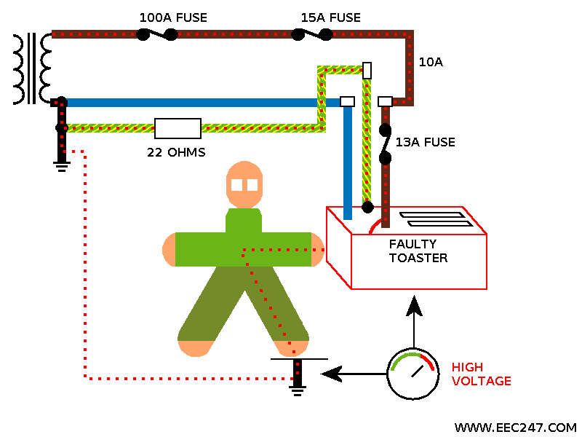
Why Electrical Safety Devices
High Voltage passing through the human body
*Source: www.EEC247.com

Slide 4
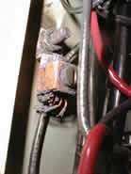
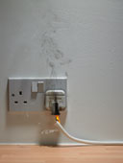
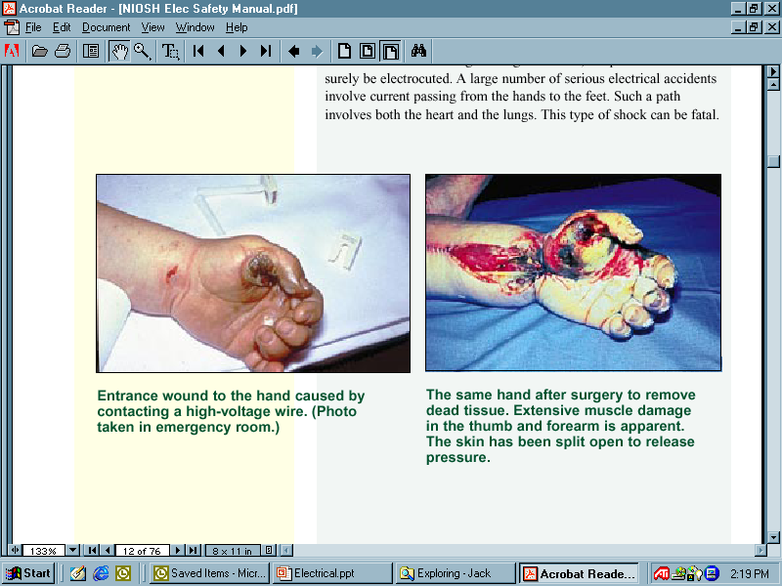
Why Electrical Safety Devices
Mainly due to electrical hazards like:
BURNS
It can result when a person touches electrical wiring or equipment that is energized.
ARC-BLAST
Arc-blasts occur from high- amperage currents arcing through the air. This can be caused by accidental contact with energized components or equipment failure.

Slide 5
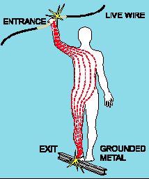
Why Electrical Safety Devices
SHOCK
Electric shock occurs when the human body becomes part of the path through which current flows.
The direct result can be electrocution*.
The indirect result can be injury resulting from a fall or movement into machinery because of a shock
* electrocution :death due to electrical shock

Slide 6
Electrical Safety Devices
Effects of Current Flow in Human Body
More than 3 milliamps (ma): painful shock
More than 10 ma: muscle contraction
More than 20 ma: considered severe shock
More than 30 ma: lung paralysis - usually temporary
More than 50 ma: possible ventricular fibrillation (usually fatal)
100 ma to 4 amps: certain ventricular fibrillation (fatal)
Over 4 amps: heart paralysis; severe burns

Slide 7
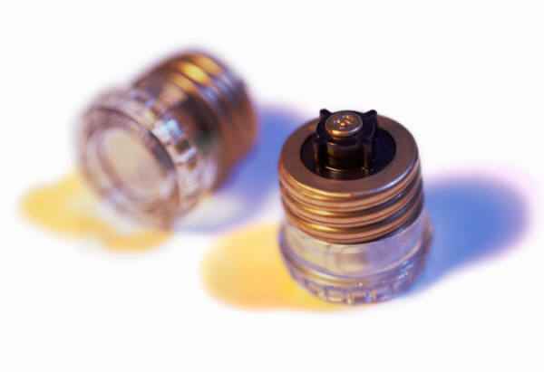
Electrical Safety Devices
Shut off electricity flow in the event of an overload or ground-fault in the circuit.
Include fuses, circuit breakers and ground-fault circuit interrupters.
Fuses and circuit breakers are “over current” devices
(too much current = fuses melt and circuit breakers “trip” open).

Slide 8

Electrical Safety Devices
FUSE
“Devices used to protect the electrical circuit from too much current flow”

Slide 9
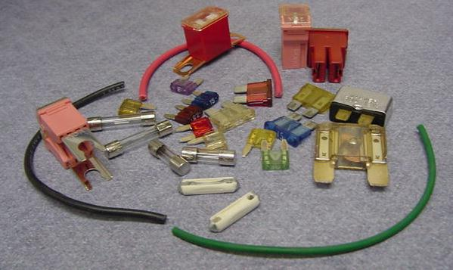
Electrical Safety Devices
FUSE
“Devices used to protect the electrical circuit from too much current flow”
It is designed to open the circuit when the current reaches a predetermined level.
They are rated in Amps
Do not install a fuse larger than is designed for the circuit

Slide 10
Electrical Safety Devices
FUSE
Types of FUSE

Slide 11
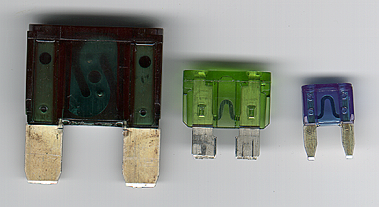
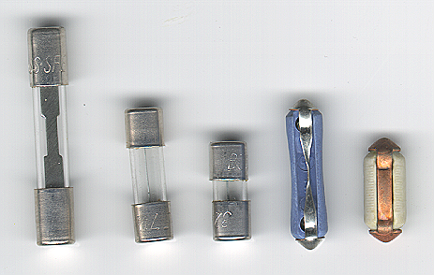
Electrical Safety Devices
FUSE
Types of FUSE
Auto-fuse (blade type & Color coded)
Mini-fuse
Maxi-fuse
Ceramic & Glass
Rated by current failure level
Three letter code for type and size
Glass style replaces ceramic

Slide 12
Electrical Safety Devices
FUSE
Advantages
Cheap
Easy replacement
High Operation Speed
Maintenance cost is practically Zero
Capable of clearing high and low fault currents
Do not deteriorate with age
Reliable operation
Disadvantages
Unreliable operation
Lack of Discrimination
Heat produced by the arc may affect the associated switches
They have to be replaced after each operation

Slide 13
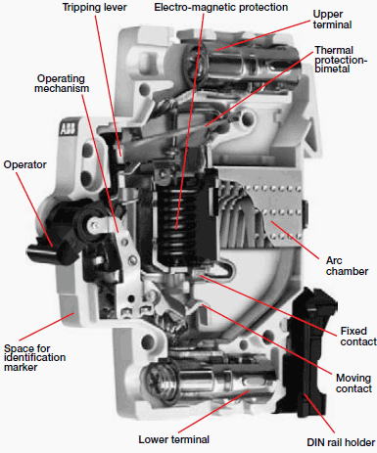
Electrical Safety Devices
MCB (Miniature Circuit Breaker)
A mechanical switching device which is capable of making, carrying and breaking currents under normal circuit conditions and also making, carrying for a specified time and automatically breaking currents under specified abnormal circuit conditions such as those of short circuit.
MCB is a device for overload and short circuit protection.
They are used in residential & commercial areas.

Slide 14
Electrical Safety Devices
Comparison of FUSE and MCB
Sr. No | Particular | Fuse | Circuit Breaker
1 | Function | It performs both detection and interruption function. | It performs interruption only.
2 | Operation | Inherently completely automatic. | Requires elaborate equipment for automatic action very large.
3 | Breaking Capacity | Small | Very large
4 | Operating time | Very small(0.002 sec. or so) | Comparatively large(0.1 to 0.2 sec)
5 | Replacement | After every operation | No replacement after every operation.

Slide 15
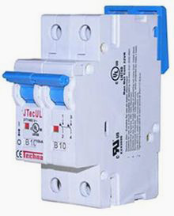
Electrical Safety Devices
MCCB (Moulded Case Circuit Breaker)
Rated current up to 1000 A.
Trip current may be adjustable.
Thermal or thermal-magnetic operation

Slide 16
Electrical Safety Devices
Comparison between MCB & MCCB
An MCB has less than 100 amps while an MCCB goes as high as 2,500 amps.
The interrupting rating for an MCB is 18,000 amps up to 200,000 amps for an MCCB.
MCBs are mostly installed for home use while an MCCB is generally utilized for commercial or industrial purposes.
Both are low-voltage circuit breakers created to respond to IEC 947 standards.
Some MCCB units are specially made to respond to remote control signals usually as standby power.
Circuit breakers are installed for safety reasons.
The location of circuit breakers in every structure should be known to the people who reside in it.

Slide 17
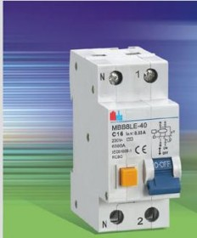
Electrical Safety Devices
ELCB(Earth Leakage Circuit Breaker)
An Earth Leakage Circuit Breaker is a safety device used in electrical installations with high earth impedance to prevent shock
ELCB is working based on Earth leakage current.
Phase (line), Neutral and Earth wire connected through ELCB.
Operating Time of ELCB:
The safest limit of Current which Human Body can withstand is 30ma sec.
Suppose Human Body Resistance is 500Ω and Voltage to ground is 230 Volt. The Body current will be 500/230=460mA. Hence ELCB must be operated in 30maSec/460mA = 0.65msec

Slide 18
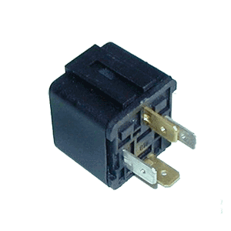
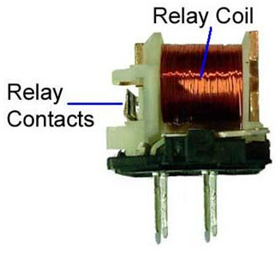
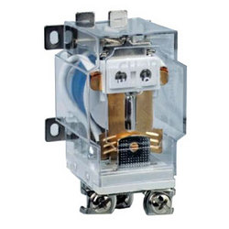
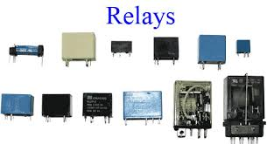
Electrical Safety Devices
RELAY

Slide 19
Electrical Safety Devices
RELAY
A switch that changes states when voltage is applied to its input.
The input connects to an electric coil. When voltage is replaced across the input, the coil magnetizes and moves a switch contact.
Why Relay
To direct electricity to a high current device like a starter motor, with the use of a light key switch)
To control devices

Slide 20

The bottom line with electricity:
RESPECT
COMMON SENSE
SAFETY

Slide 21
Thank you

